Slide 1


Employee Retention Project
HR1 & HR2, Group 2

Slide 2
Group Details
NAME E-Mail ID Mobile Number
Ranjith.S.D ranjithsd14@gmail.com 8553263845
Mr. Akshay kumar aspsa3@gmail.com 8789166826
Mr. Cyril Kavinal Babu cyrilkavs97@gmail.com 8848391037
Ms. NITHYASRI.A nithyasrijain@gmail.com 6379268447
Mr. Deekshith potlachervu pdeekshith006@gmail.com 9182173843
Niraj Kumar nirajkumarbth034@gmail.com 9199895184
Shaik Abdul Haseeb shaikhaseeb716@gmail.com 9381887434

Slide 3
PROJECT SUMMARY
Project Title- Employee Retention Project
Objectives-
Human Resources (HR) analysis on a data analyst typically involves an in-depth evaluation of various aspects related to the performance, contribution, and impact of data analysts within an organization.
This analysis aims to derive insights into their efficiency, productivity, skill sets, and overall value they bring to the company
Scope-
Data Collection and Analysis
Predictive Modeling
Designing Retention Strategies
Employee Feedback and Engagement
Managerial Training and Support
Timeline-
The timeline for ERP project is scheduled from 24Nov to 23Dec

Slide 4
Project Overview
In this project, we have used different types of analytical tools like Excel, Tableau, Power BI, SQL
We have created different dashboards on Lead and Opportunity Tables
Also, we have described various types of Key Performance Indicators (KPIs)

Slide 5
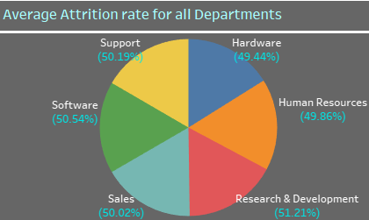
From Average Attrition rate for all Departments
We got-
>Highest attrition is on the research & development (51.21%)
>lowest attrition is on the Hardware (49.44%)

Slide 6
From Average Hourly rate of Research Scientist
We got -
>Average Hourly rate of Male Research Scientist is 116
>Average Hourly rate of Female Research Scientist is 115

Slide 7
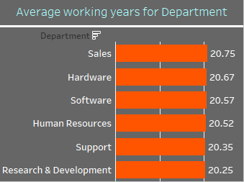
From Average working years for each Department
Avg. working years show how many year employees work on given department.
We got –
> Highest Avg. working years is on “Sales” department (20.75)
> Lowest Avg. working years is on “Research & Development” department (20.25)

Slide 8
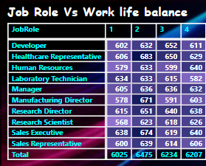
From Job Role Vs Work life balance
Work life balance show satisfaction of employees with our work . if employees give low rating it mean they not satisfy with our work.
We got –
>More number of employee give 2 work life balance.

Slide 9
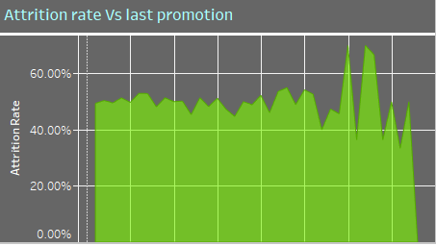
From Attrition rate Vs Year since last promotion relation
If people leave company in few year this show employees not satisfied with our work.
We got –
>In the last 1 to 25 years Attrition rate is around 50%
>highest attrition 70% on last 30 year
>lowest attrition 33% on last 36 year

Slide 10
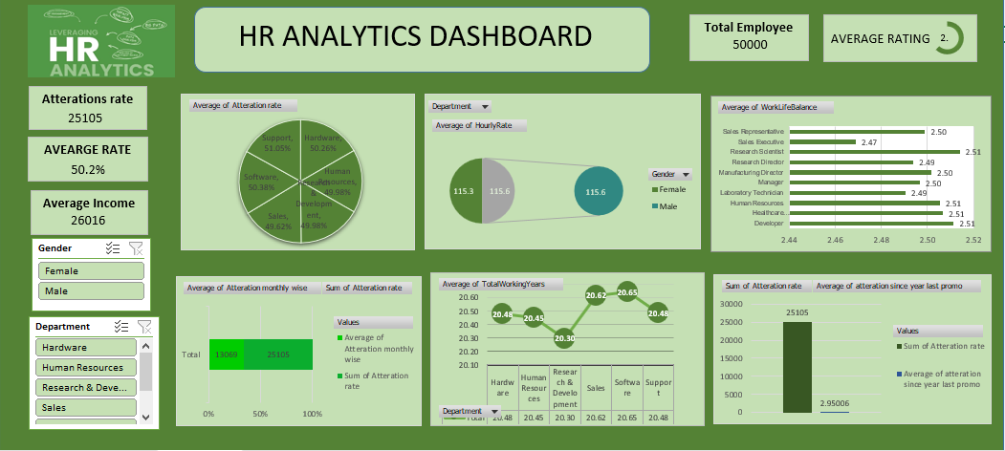
Excel dashboard

Slide 11
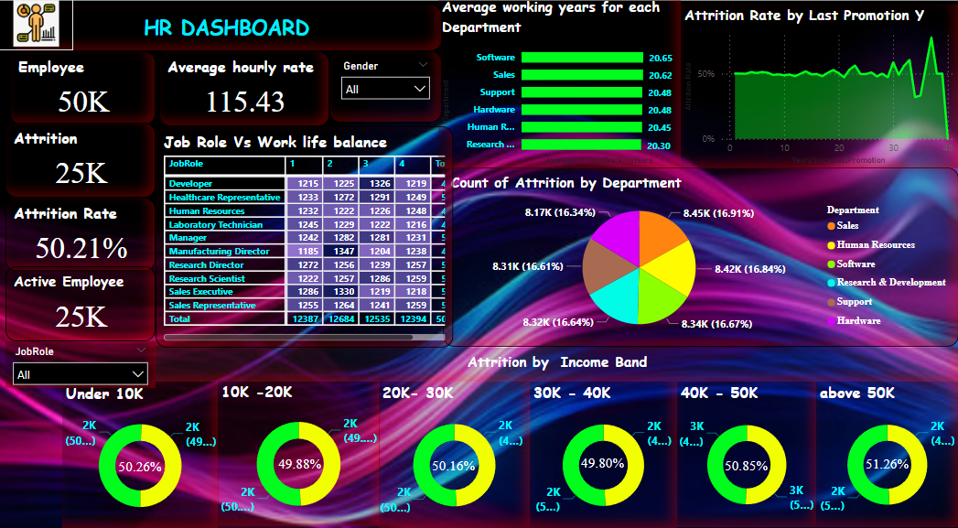
Power bi Dashboard

Slide 12
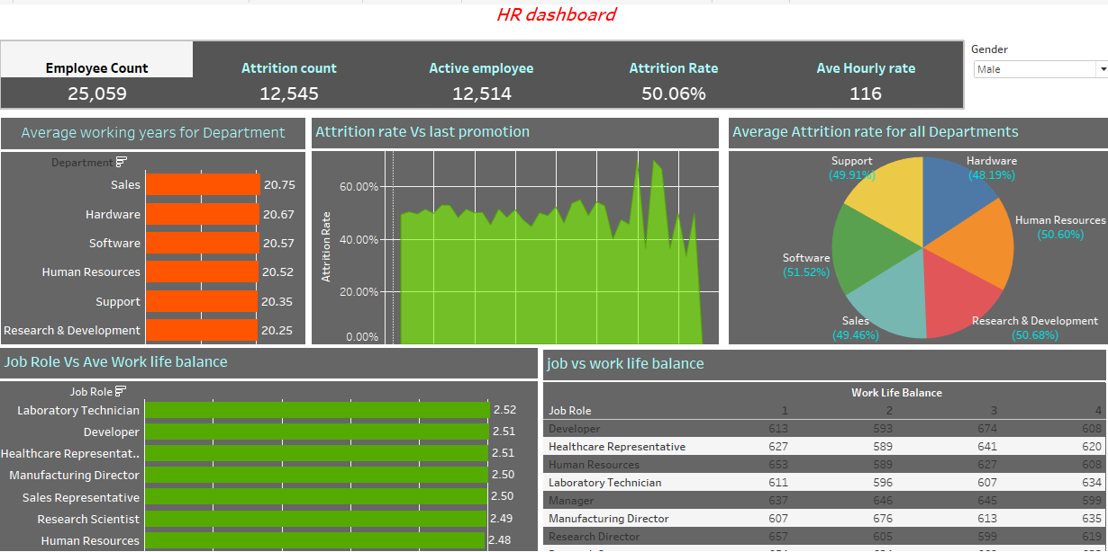
Tableau Dashboard

Slide 13
Conclusion
company need to improve working condition of research & development department because its attrition rate is high and Avg. working years is low in all department, that show employees are not satisfied here .
Average Hourly rate of Male Research Scientist is higher then female, it mean work load is higher on the male employee.
most of employees in Healthcare representative, Manufacturing Director and sales executive give 2 work life balance . This show employees not satisfied with their salary . company need to improve their salary .

Slide 14
THANK YOU

